Slide 1
Investigating Equipping GPT-4 with Numeric Calculation
github.com/githubnext/gpt4-with-calc
Don Syme (dsyme@github.com) + all of GitHub Next esp Johan and Albert

Slide 2
Equipping for Numeric Calculation
The situation:
Any GPT-4 Chat: Context + Question ⇒ Answer

Slide 3
Equipping for Numeric Calculation
The situation:
Any GPT-4 Chat: Context + Question ⇒ Answer
The problem:
GPT-4 is terrible at numeric calculations
It’s also terrible at numeric comparisons
GPT-4 should not be trusted to write a number that is not present verbatim in the input, nor to reason about numbers in any significant way. In trust scenarios, don't allow GPT-4 to write numbers, and beware that every numeric comparison may be flawed.

Slide 4
How bad is this?
It’s bad

Slide 5
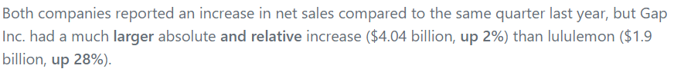

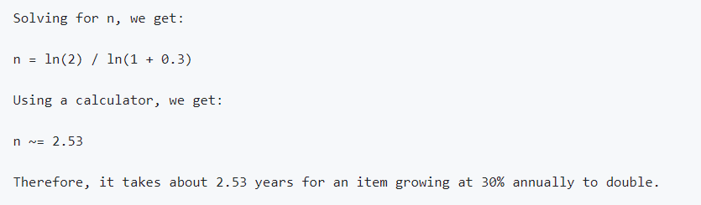
Example fails
Comparing financial documents
Example problem:
More example problem:

Slide 6
The Hope
The observation:
👎GPT-4 is terrible at numeric calculations
👍GPT-4 is good at writing numeric calculation code

Slide 7
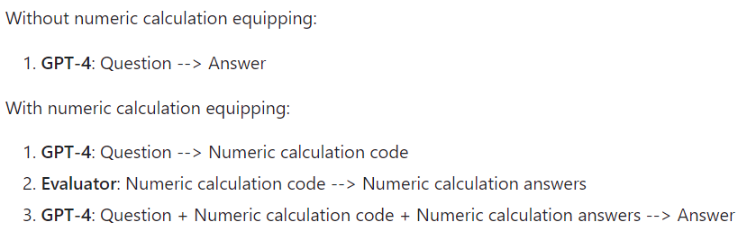
The Hope made Real
My opinion: this two-phase technique should be incorporated into every GPT-4 request that involves numbers unless explicitly known to be calculation-free. Anything else is

Slide 8
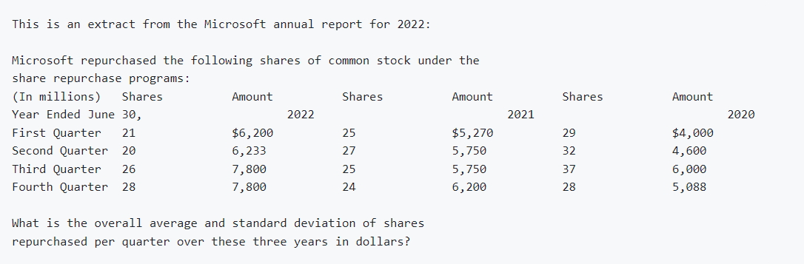
Example question

Slide 9
Example fail

Slide 10
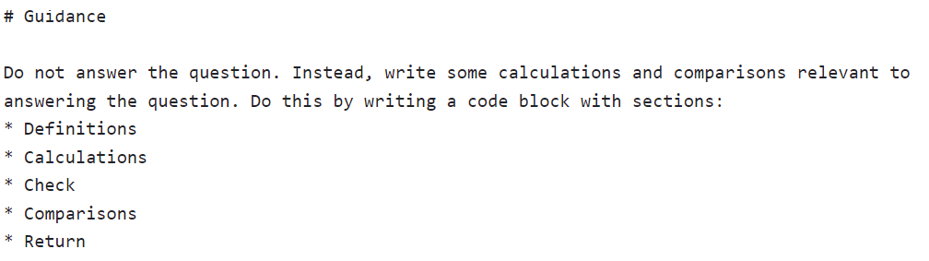
Example prompt

Slide 11
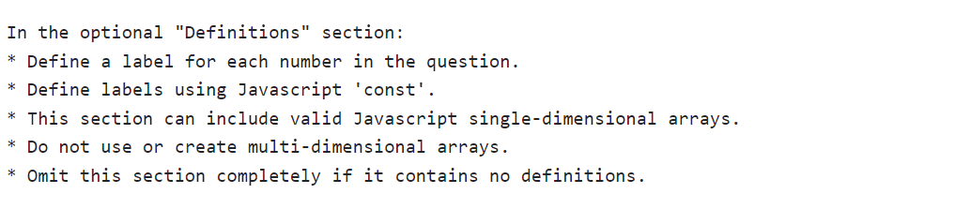
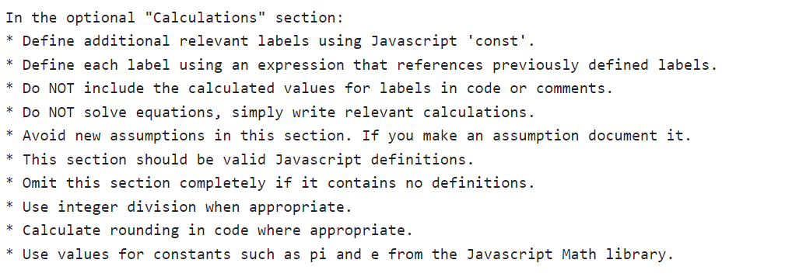
Example prompt

Slide 12
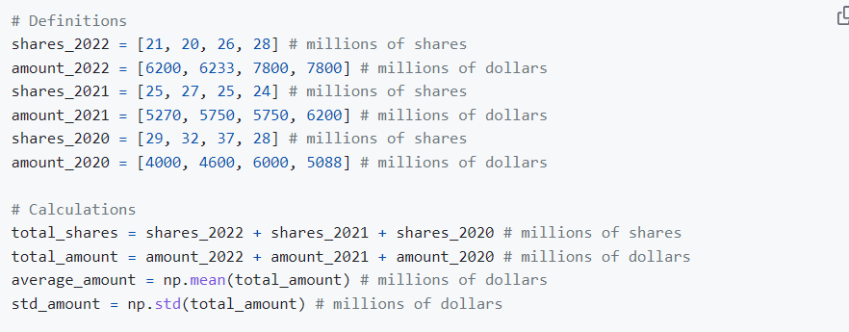
Example relevant calculation code

Slide 13
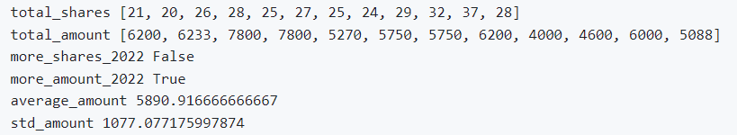
Example relevant results
Add code + results to the prompt, before the question

Slide 14
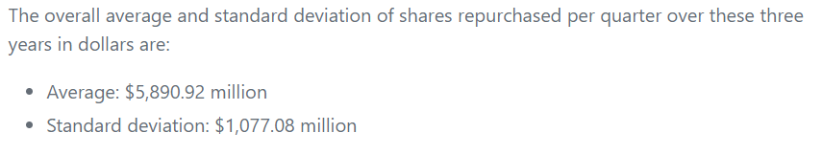
Example answer

Slide 15
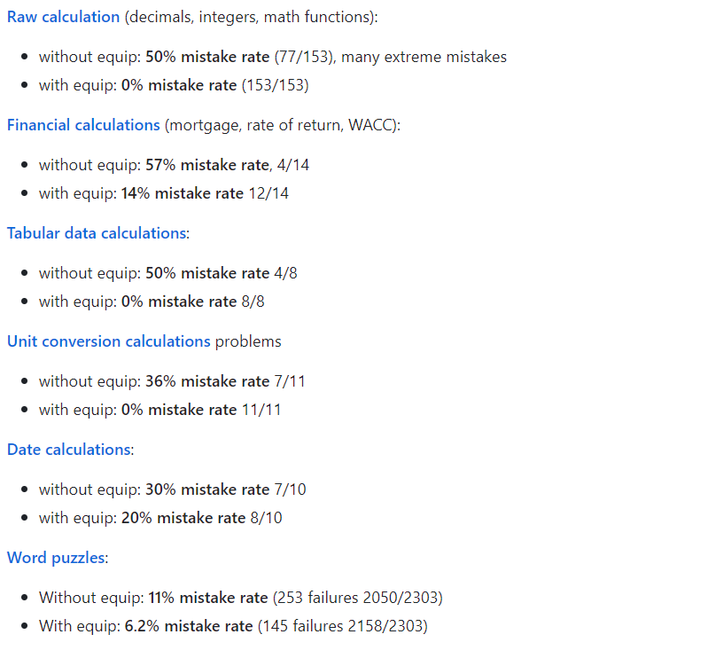
Effective?

Slide 16
Bonus topics
It’s not just calc, it’s comparisons too
Units of measure can be extracted and “tracked”
Self-checks
Commenting your calculations matters

Slide 17

The Devil is in the Detail
Every step of an LLM can introduce hallucination.
Example: hallucinated numbers in calculation code

Slide 18
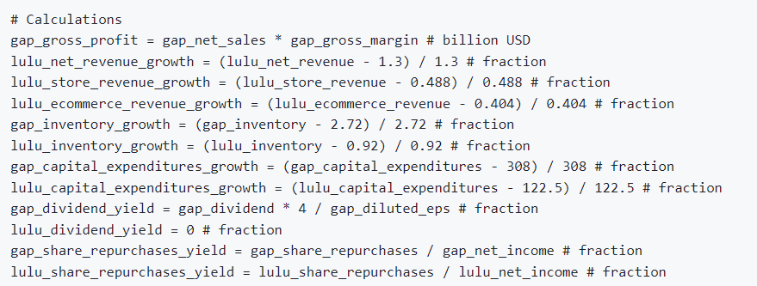

Slide 19
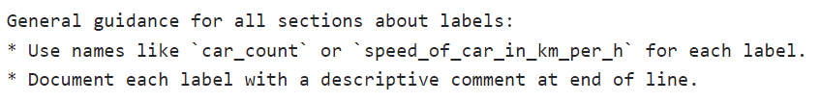
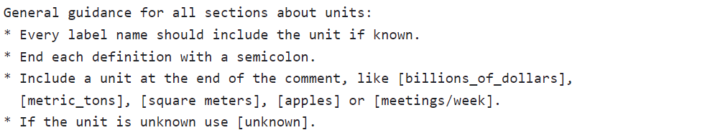
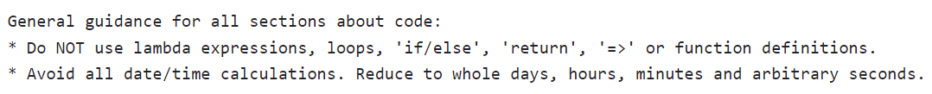
Example prompt

Slide 20
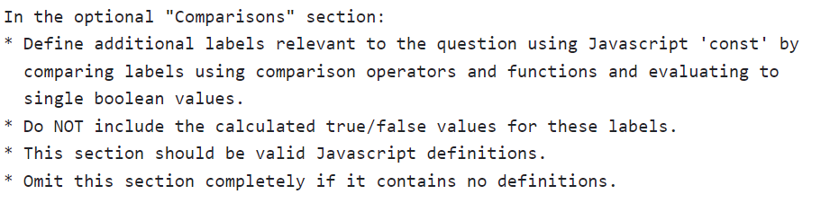

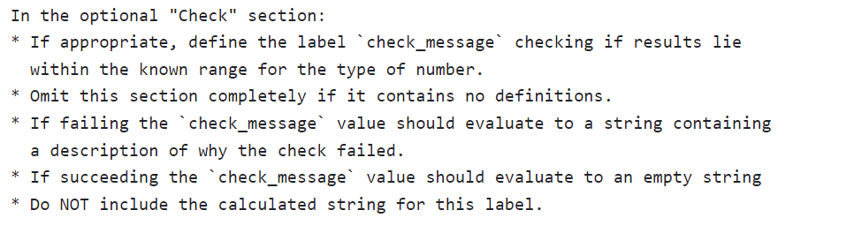
Example prompt

Slide 21
TLDR
Calc is hard for AI. Writing calc code is easy
Numeric calc is the “hello world” of trustworthy systems
Numbers are always “rational”. They must always have an explanation.

Slide 22
Chat and Trust
The integration of Chat, Data and Programming is coming very fast. Much faster than I expected even a month ago.
The industry is crying out for AI that can be trusted, explained, can generate recognisable, analyzable artifacts like spreadsheets and notebooks.
By generating calculation code, we have a stepping stone to this.
Important: chat is not just one thing:
Chat for Entertainment
Chat for Search
Chat for Analytical Question Answering
Chat for Technical Creation
Chat for Tax Returns

Slide 23
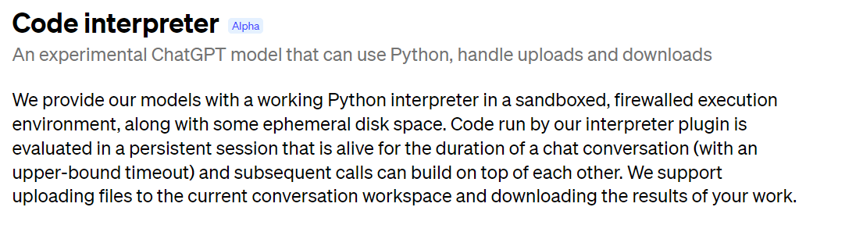

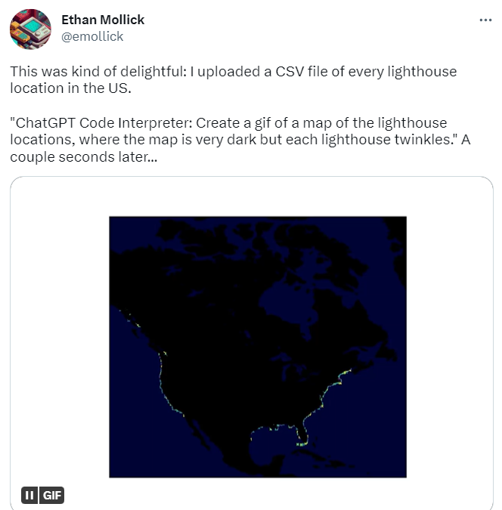
“Code Interpreter” ChatGPT AddIn

Slide 24

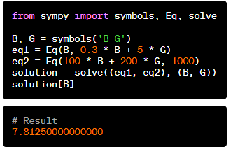
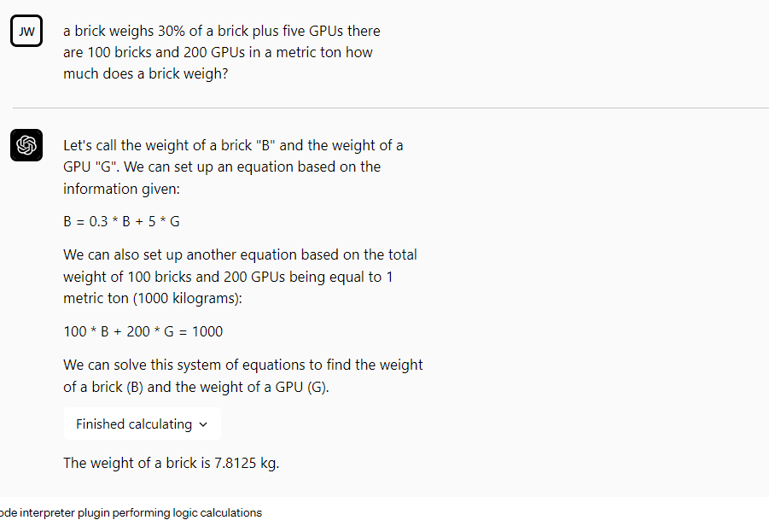

Slide 25
Beyond simple calc
This category of technique can be applied to any language, computational logic, DSL, query language, library, service or computational capability.
The outputs can be answers, code, notebooks, proofs, spreadsheets, projects, tests, documentation.
And tax returns.

Slide 26
Questions for these times
Hardened, reliable, trustworthy calculation/reasoning systems are utterly critical
Proof, evidence, reasoning, explanation, audit, provenance and blame are critical in trust domains
What is “correct” code?
What establishes trust?
What is “evidence” that the chosen code or query is correct?
What ontologies, rule/code databases, calc/logic engines help establish trust and confidence?
How do we document what assumptions have been made?
e.g. which calculation formula has been used and what’s a reference for it?

Slide 27

Thank you!
dsyme@github.com

